Slide 1
Lecture 3:
Tumor viruses (肿瘤病毒)
Oct 18, 2023
Notes:
现代肿瘤研究是从病毒研究开始的，所以此章节会讲述肿瘤研究的发展历史。

Slide 2
Outline of today`s lecture
Nobel prize history
1926
1, Is cancer an infectious disease?
2, Rous Sarcoma virus;
3, Cell transformation in culture;
4, RNA and DNA virus in cancer;
5, identification of virus oncogene src;
6, Cellular proto-oncogene;
1966
1975
1989
Notes:
肿瘤研究的历史，3，革命性研究方法细胞体外培养的发展历史； 。。。 细胞原癌基因 又是癌症认识概念性突破。。。

Slide 3
What is the nature of tumor in early 20th century?
Notes:
开始讲述肿瘤研究历史。。。

Slide 4
Louis Pasteur (路易·巴斯德)and infectious agents
In the last two decades of the nineteenth century, the research of Louis Pasteur uncovered the infectious agents that were responsible for dysentery(痢疾), cholera(霍乱), rabies(狂犬病), and a number of other diseases. By the end of 19th century, these agents had been placed into two distinct categories. Solutions of infectious agents that were trapped in the pore of filters were considered bacteria, agents pass through filters were classified as viruses.
Is cancer also an infectious disease(传染病)?

Slide 5
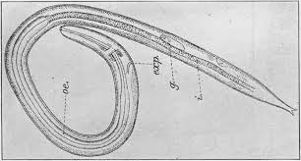
Cancer caused by worms?
First Nobel Prize in cancer field
By 1913, Grib Fibiger reported that stomach cancers in rats could be traced to spiroptera (螺旋体) worms that they harbored. He received 1926 Nobel Prize for this.
One year later after the 1926 Nobel Prize. People realized that that the stomach tumors he described were not tumor at all. Instead, they were found to be metaplastic(化生的) stomach epithelia that were the result of the profound vitamin deficiencies suffered by these rats; they lived in sugar refineries(糖厂) and ate sugar cane(甘蔗) almost exclusively.
Notes:
一个假象(artefact)，我们实验中也经常碰到。

Slide 6
3.1 Peyton Rous discovers a chicken sarcoma virus

Slide 7
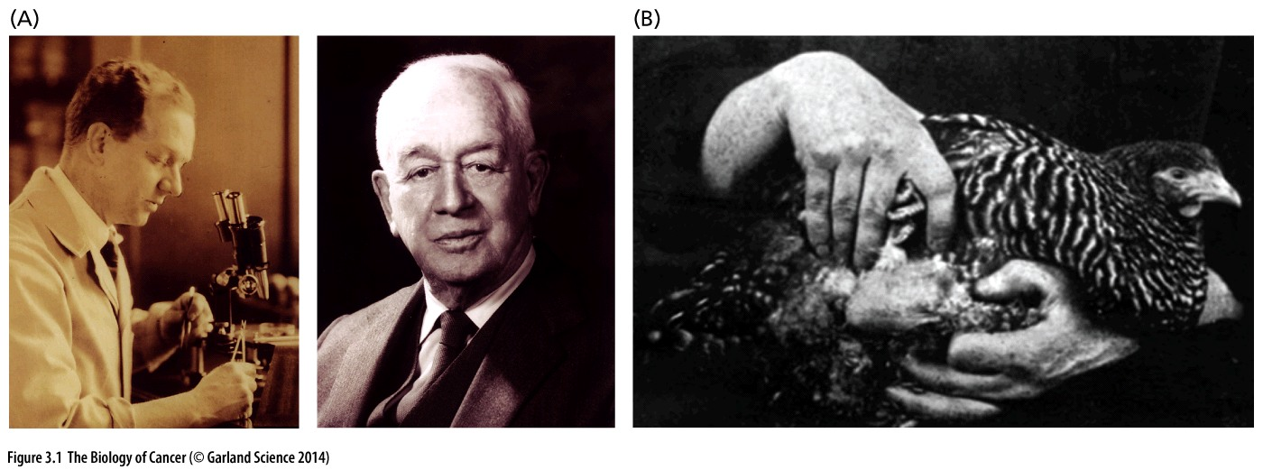
Figure 3.1 Peyton Rous and the hen that launched modern cancer research
(A) Francis Peyton Rous began his work in 1910 that led to the discovery of Rous sarcoma virus (RSV) (left). More than 50 years later (1966), he received the Nobel Prize in Medicine and Physiology for this seminal work—a tribute to his persistence and longevity (right). (B) His good fortune began when a Long Island, NY chicken farmer brought Rous, then working at the Rockefeller Institute in New York, a prized barred Plymouth Rock hen. The farmer wanted Rous to treat the large tumor growing in its chest muscle（胸肌）; Rous saw experimental opportunity and dispatched the hen, extracting the tumor.
Second Nobel Prize in cancer field
Notes:
Peyton Rous is the oldest Nobel laureate in Medicine ever (at the age of 87)，由于1926年假象获得Nobel prize，给后面肿瘤领域诺奖带来很大阻力。

Slide 8
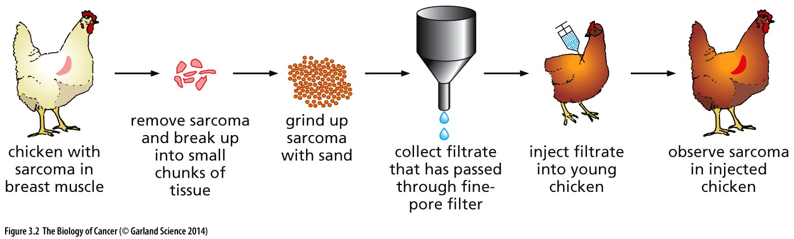
Figure 3.2 Rous’s protocol for inducing sarcomas in chickens
Rous removed a sarcoma from the breast muscle of a chicken, ground it with sand, and passed the resulting homogenate through a fine-pore filter. He then injected the filtrate (the liquid that passed through the filter) into the wing web of a young chicken and observed the development of a sarcoma many weeks later. He then ground up this new sarcoma and repeated the cycle of homogenization, filtration, and injection, once again observing a tumor in another young chicken. These cycles could be repeated indefinitely; after repeated serial passaging, the virus produced sarcomas far more rapidly than the original viral isolate.
Notes:
为什么越来越快？

Slide 9
Basics of virus
Definition of a Virus
Sub microscopic infective agent consisting of nucleic acid surrounded by a protein coat and capable of replication only within the living cells of bacteria, animals or plants.

Slide 10
Virus classification
Baltimore classification （Named after David Baltimore）
I: dsDNA viruses (e.g. Adenoviruses, Herpesviruses, Poxviruses)
II: ssDNA viruses (+ strand or "sense") DNA (e.g. Parvoviruses)
III: dsRNA viruses (e.g. Reoviruses)
IV: (+)ssRNA viruses (+ strand or sense) RNA (e.g. Picornaviruses, Togaviruses)
V: (−)ssRNA viruses (− strand or antisense) RNA (e.g. Orthomyxoviruses, Rhabdoviruses)
VI: ssRNA-RT viruses (+ strand or sense) RNA with DNA intermediate in life-cycle (e.g. Retroviruses)
VII: dsDNA-RT viruses (e.g. Hepadnaviruses)
Notes:
纪念David Baltimore对病毒研究的贡献，David Baltimore is one of the most influential biomedical scientist in USA. Coronaviruses contain a positive-sense, single-stranded RNA genome. The genome size for coronaviruses ranges from 26.4 to 31.7 kilobases.

Slide 11
Common virus
Human immunodeficiency virus (HIV)
HIV is a member of the genus Lentivirus, part of the Retrovirus family
Diameter of about 120 nm
It is composed of two copies of positive single-stranded RNA
Moloney murine leukemia virus (MMLV),
90 nm in diameter, Retrovirus family
The viral genome is a single stranded, linear, positive-sense RNA molecule of around 8000 nucleotides. From 5' to 3' (typically displayed as "left" to "right"), the genome contains gag, pol, and env regions, coding for structural proteins, enzymes including the RNA-dependent DNA polymerase (reverse transcriptase), and coat proteins, respectively.
Adenoviruses
(members of the family Adenoviridae) are medium-sized (90–100 nm), nonenveloped (without an outer lipid bilayer) viruses with an icosahedral(二十面的) nucleocapsid containing a double stranded DNA genome.
Coronavirus
They are enveloped viruses with a positive-sense single-stranded RNA genome and a nucleocapsid of helical symmetry. The genome size of coronaviruses ranges from approximately 26 to 32 kilobases, one of the largest among RNA viruses. They have characteristic club-shaped spikes that project from their surface, which in electron micrographs create an image reminiscent of the stellar corona, from which their name derives.

Slide 12
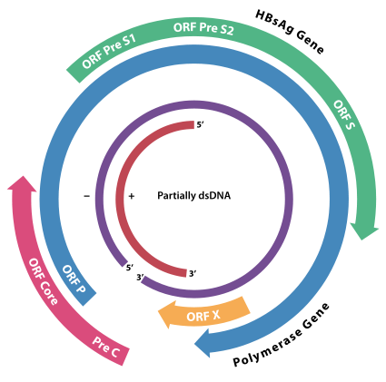
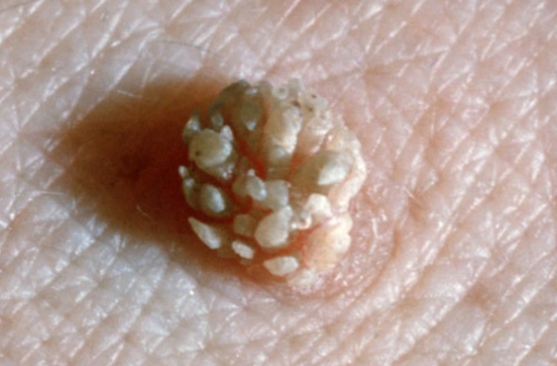
Hepatitis B virus (HBV，乙肝病毒)
Diameter is about 42 nm. The genome of HBV is made of circular DNA, but it is unusual because the DNA is not fully double-stranded. One end of the full length strand is linked to the viral DNA polymerase. The genome is 3020–3320 nucleotides long (for the full length strand) and 1700–2800 nucleotides long (for the short length strand).
Hepatitis C virus (HCV，丙肝病毒)
55–65 nm in size, enveloped, positive-sense single-stranded RNA virus of the family Flaviviridae.
RNA-dependent RNA polymerase inhibitor Sofosbuvir, 2016 Lasker award;
Human papillomavirus (HPV，人乳头瘤病毒)
Non-enveloped DNA tumor viruses with a virion size of ∼55 nm in diameter.
HPV is the most common sexually transmitted infection globally, HPV increases the risk for cancers of the cervix（子宫颈） , penis, vagina, anus, and oropharynx.
尖锐湿疣（Genital warts），HPV诱发
Notes:
第一章提到约20%的人类肿瘤的直接致病因素是病毒，其中以HBV， HCV， HPV为最常见以及重要。本章节的RSV发现于鸡，与人的肿瘤没有直接关系。

Slide 13
Virus vectors for gene delivery
Commonly used viral vectors:
Retroviruses
Moloney murine leukemia virus (MMLV),
The primary drawback to use of retroviruses such as the Moloney retrovirus involves the requirement for cells to be actively dividing for transduction.
Lentiviruses
Lentiviruses are a subclass of Retroviruses. They have recently been adapted as gene delivery vehicles (vectors) thanks to their ability to integrate into the genome of non-dividing cells, which is the unique feature of Lentiviruses as other Retroviruses can infect only dividing cells.
Adenoviruses
As opposed to lentiviruses, adenoviral DNA does not integrate into the genome and is not replicated during cell division.
Adeno-associated viruses
AAV is not currently known to cause disease and consequently the virus causes a very mild immune response.
Delivery of genes by a virus is termed transduction (转导);
Notes:
Transfection 转染

Slide 14
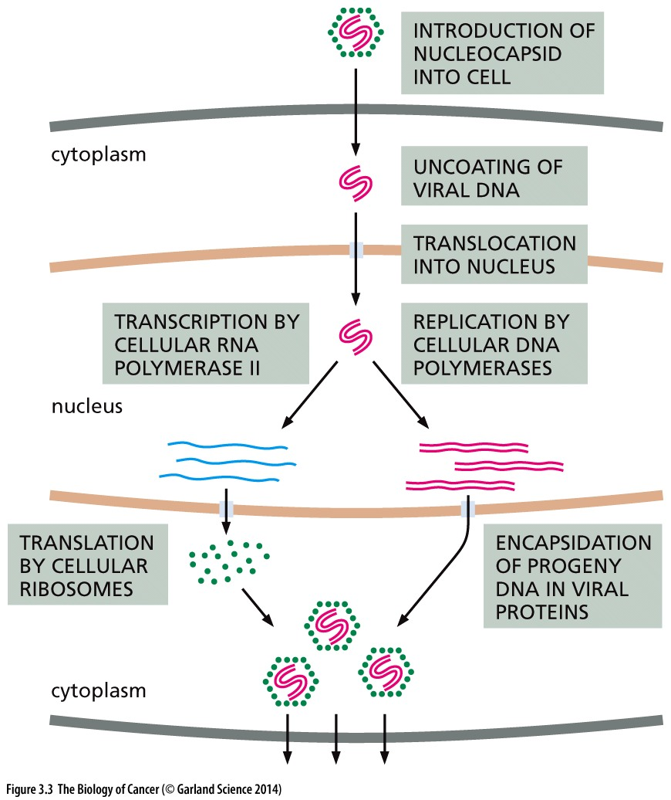
Figure 3.3 Life cycle of viruses with dsDNA genomes
The life cycle of viruses with double-stranded DNA (dsDNA) genomes closely parallels that of the host cell. Almost all of the steps leading to the synthesis of viral DNA, RNA, and proteins can be achieved by using the synthetic machinery provided by the infected host cell. Not shown here is the release of progeny virus particles from the infected cell.

Slide 15
3.2 Rous sarcoma virus (RSV) is discovered to transform infected cells in culture

Slide 16
The rebirth of Rous sarcoma virus research began largely at the California Institute of Technology in Pasadena, in the laboratory of Renato Dulbecco. Dulbecco’s postdoctoral fellow Harry Rubin found that when stocks of RSV were introduced into Petri dishes carrying cultures of chicken embryo fibroblasts, the RSV-infected cells survived, apparently indefinitely.
Notes:
Peyton Rous 发现了Rous sarcoma virus ，但是他自己在病毒功能方面并未做出显著成绩。

Slide 17
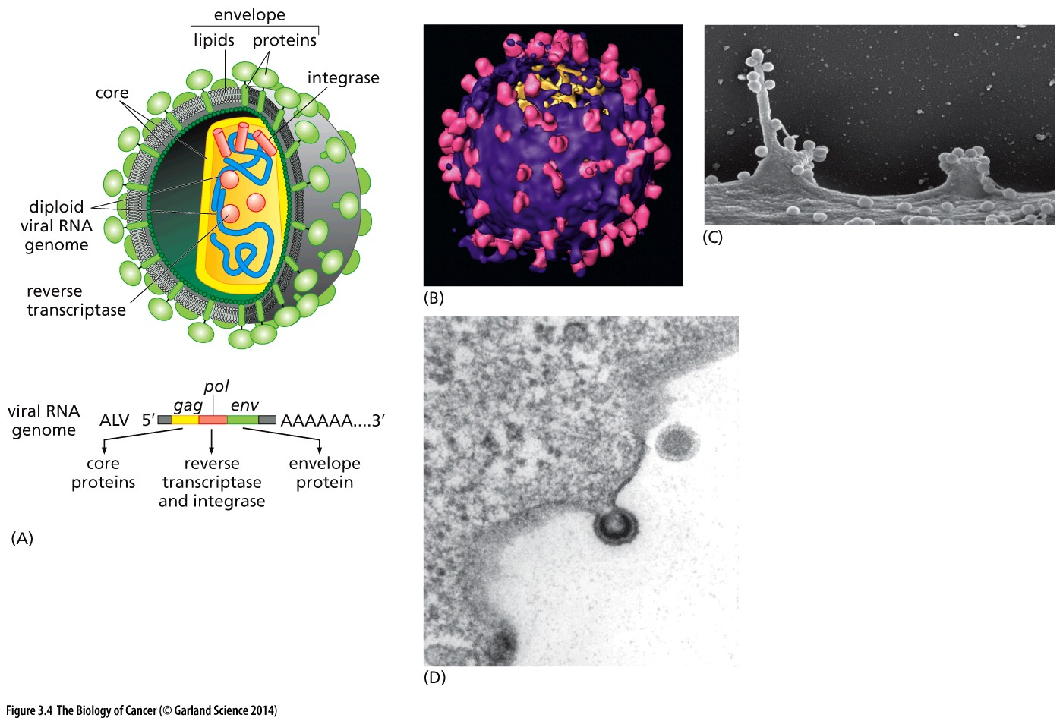
Figure 3.4 The virion(病毒粒子) of RSV and related viruses
Notes:
RSV是经典retrovirus的代表，也是这节课的主角，下面几张高清图片展示该类病毒结构。。。

Slide 18
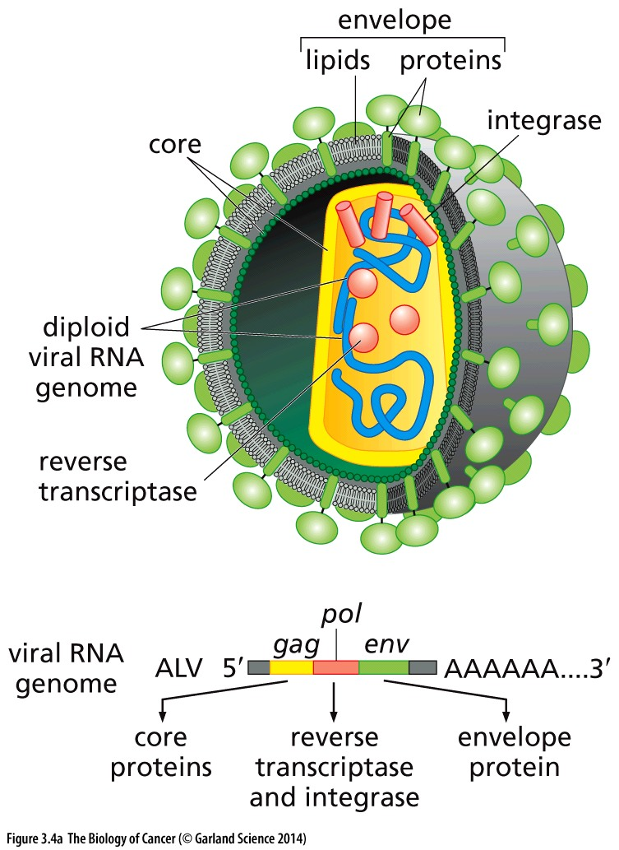
An artist’s reconstruction of the structure of a retrovirus virion, such as that of Rous sarcoma virus, which has four major types of viral proteins. The glycoprotein spikes (encoded by the viral env gene) that protrude from the lipid bilayer enable the virion to adsorb to the surface of a cell and to introduce its contents into the cytoplasm. Beneath this envelope lies a protein shell formed by the several core proteins encoded by the viral gag gene. Within this protein shell are two identical copies of the viral genomic RNA and a number of reverse transcriptase and integrase molecules specified by the viral pol gene.

Slide 19
Function of retroviral gag, pol, env gene
gag gene, which encodes the proteins that, together with the viral RNA, form each virion’s nucleoprotein core (see Figure 3.4); the pol gene, which encodes the reverse transcriptase and integrase; and the env gene, which specifies the glycoprotein spikes of the virion.

Slide 20
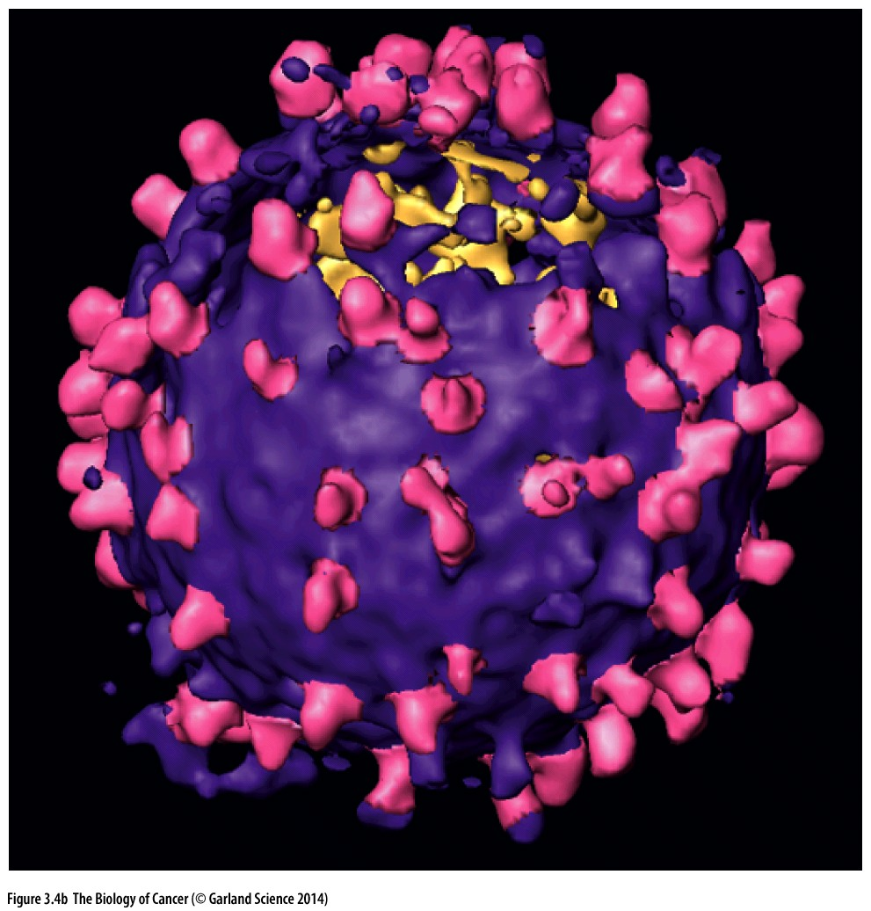
Cryoelectron microscopy and complex image processing algorithms have produced the first high-resolution reconstructed image of a murine leukemia virus (MLV) virion; MLV is related to RSV, and its virion has a structure similar to that of RSV. The glycoprotein spikes are seen here in magenta(品红色), while the lipid bilayer of the virion is shown in purple; parts of the underlying nucleocapsid(核壳体), revealed at lower resolution, are shown in yellow.

Slide 21
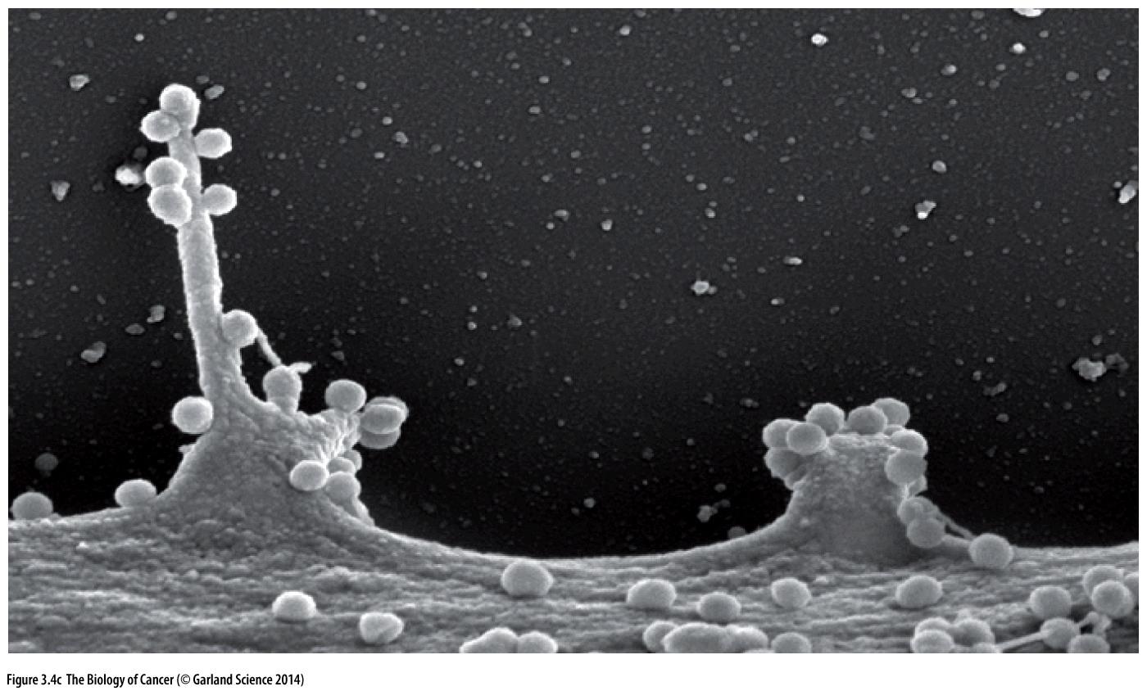
Scanning electron micrograph of human immunodeficiency virus (HIV) nucleocapsid cores budding from the surface of baby hamster(仓鼠) kidney (BHK) cells; HIV-infected lymphocytes generate similar images. HIV is a member of the same family of viruses as RSV and MLV.

Slide 22
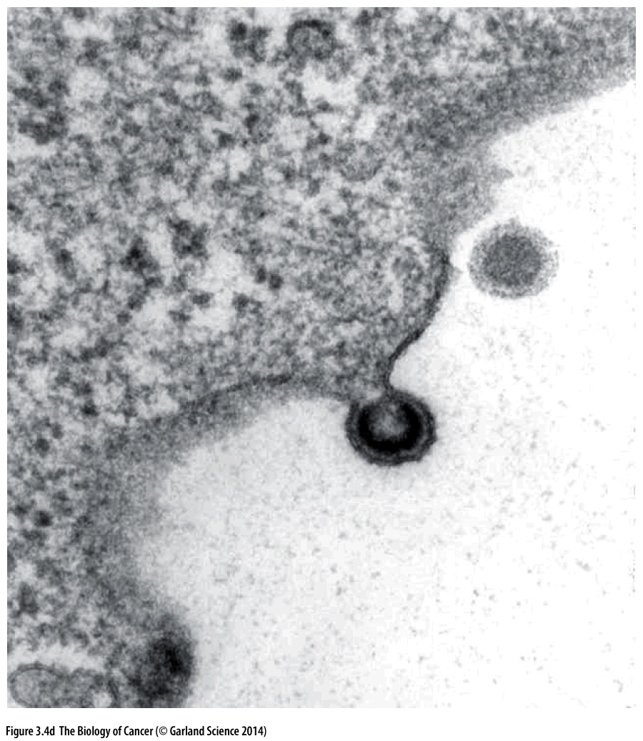
Transmission electron micrograph showing murine leukemia virus (MLV) particles budding from the surface of an infected cell. As the nucleocapsid cores (containing the gag proteins, the virion RNA, and the reverse ranscriptase and integrase enzymes) leave the cell, they wrap themselves with a patch of lipid bilayer taken from the plasma membrane of the infected cell.

Slide 23
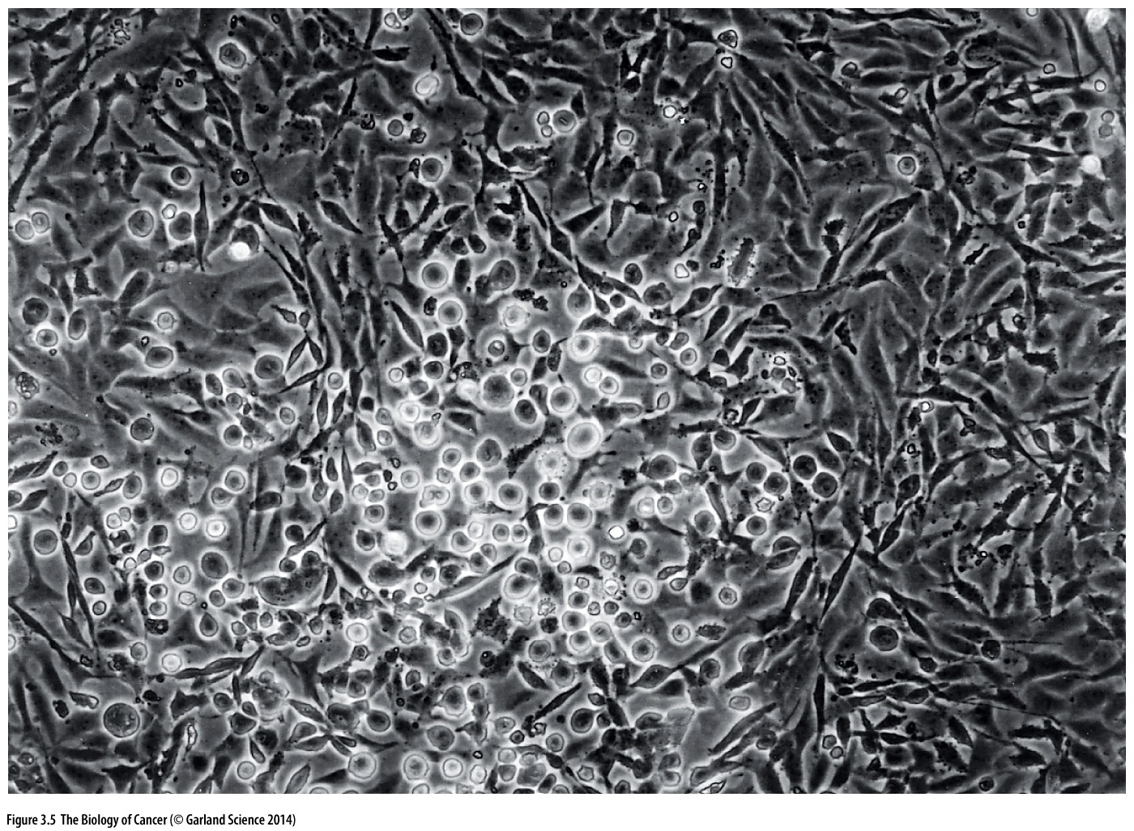
Figure 3.5 An RSV-induced focus
This phase-contrast micrograph reveals a focus of Rous sarcoma virus–transformed chicken embryo fibroblasts surrounded by a monolayer of uninfected cells. The focus stands out because it is composed of rounded, refractile(能折射的) cells that are beginning to pile up on one another, in contrast to the flattened morphology of the surrounding normal cells, which stop proliferating after they have produced a layer of cells one cell thick.
Notes:
Dulbecco’s postdoctoral fellow Harry Rubin found …

Slide 24
In vitro cell culture (细胞体外培养)
Common cell culture medium:
DMEM + 10% Fetal bovine serum (FBS, 胎牛血清) + penicillin streptomycin (青霉素, 链霉素)
Incubator (培养箱):
37 degree; 5% CO₂; 20% O₂;
In vitro culture mimic the conditions of cells in the body
Notes:
为什么要5%CO2？FBS在细胞培养中的功能？

Slide 25
Dulbecco's Modified Eagle's Medium (DMEM)
DMEM is the most commonly used medium for cell culture, was developed by Renato Dulbecco.
1975 Nobel Prize in Physiology or Medicine for "their discoveries concerning the interaction between tumour viruses and the genetic material of the cell."
Renato Dulbecco (February 22, 1914 – February 19, 2012)
Howard Martin Temin (December 10, 1934 – February 9, 1994)
David Baltimore (March 7, 1938-
Notes:
1959年DMEM配方发表；

Slide 26
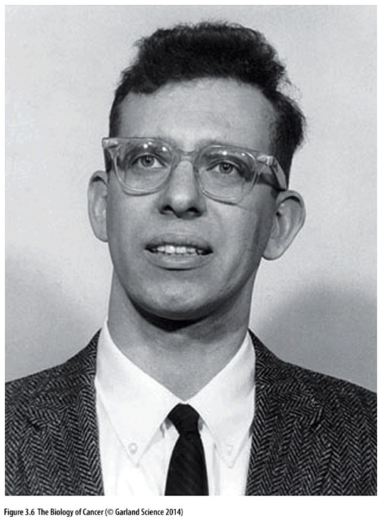
Figure 3.6 Howard Temin
Pictured here in 1964, began his work by demonstrating the ability of Rous sarcoma virus to transform cells in vitro, and showed the persistence of the virus in the infected, transformed cells. He postulated the existence of a DNA provirus and subsequently shared the 1975 Nobel Prize in Physiology or Medicine with David Baltimore for their simultaneous discoveries of the enzyme reverse transcriptase.

Slide 27
The Nobel Prize in Physiology or Medicine, 1975
“for their discoveries concerning the interaction between tumor viruses and the genetic material of the cell ”
Notes:
David Baltimore is still living and extremely influential in US biomedical science

Slide 28
Cell transformation (细胞转化)— conversion of a normal cell into a tumor cell—could be accomplished within the confines of a Petri dish(培养皿), not just in the complex and difficult-to-study environment of a living tissue.
These simple observations radically changed the course of twentieth-century cancer research, because they clearly demonstrated that cancer formation could be studied at the level of individual cells whose behavior could be tracked closely under the microscope. So, an increasing number of biologists began to view cancer as a disease of malfunctioning cells rather than abnormally developing tissues.
Notes:
革命性的细胞培养技术开始了......体外培养的细胞也能反映真实体内的情况

Slide 29
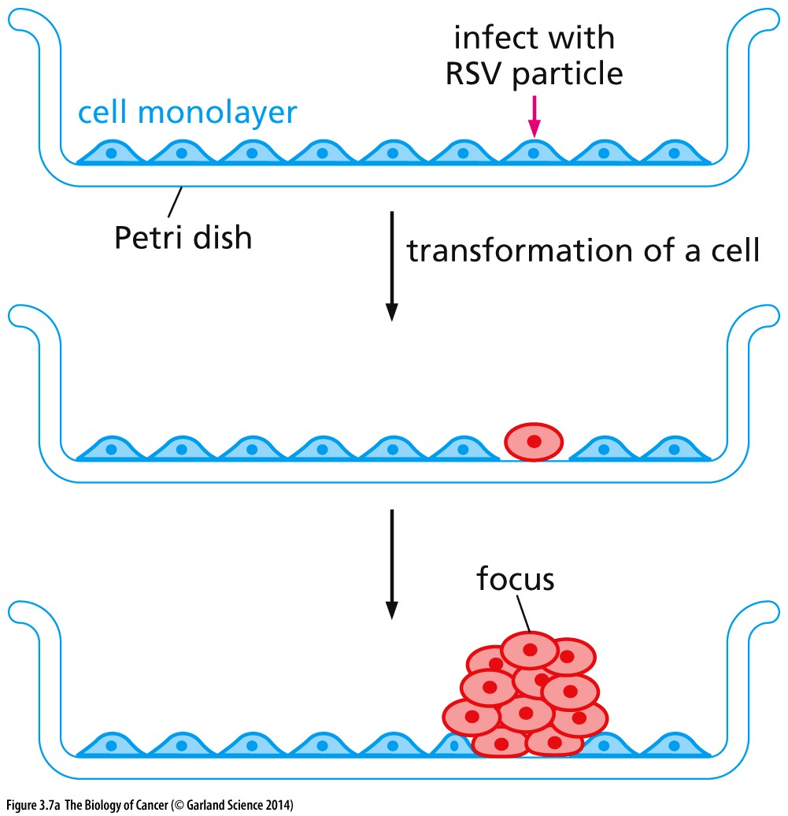
Figure 3.7 Transformed cells forming foci
(A) Normal chicken embryo fibroblasts (blue) growing on the bottom of a Petri dish form a layer one cell thick—a monolayer. This is formed because these cells cease proliferating when they touch one another—the behavior termed “contact inhibition”(接触抑制) However, if one of these cells is infected by RSV prior to reaching confluence, this cell (red) and its descendants acquire a rounded morphology and lose contact inhibition. As a consequence, they continue to proliferate in spite of touching one another and eventually accumulate in a multilayered clump of cells (a focus) visible to the naked eye.

Slide 30
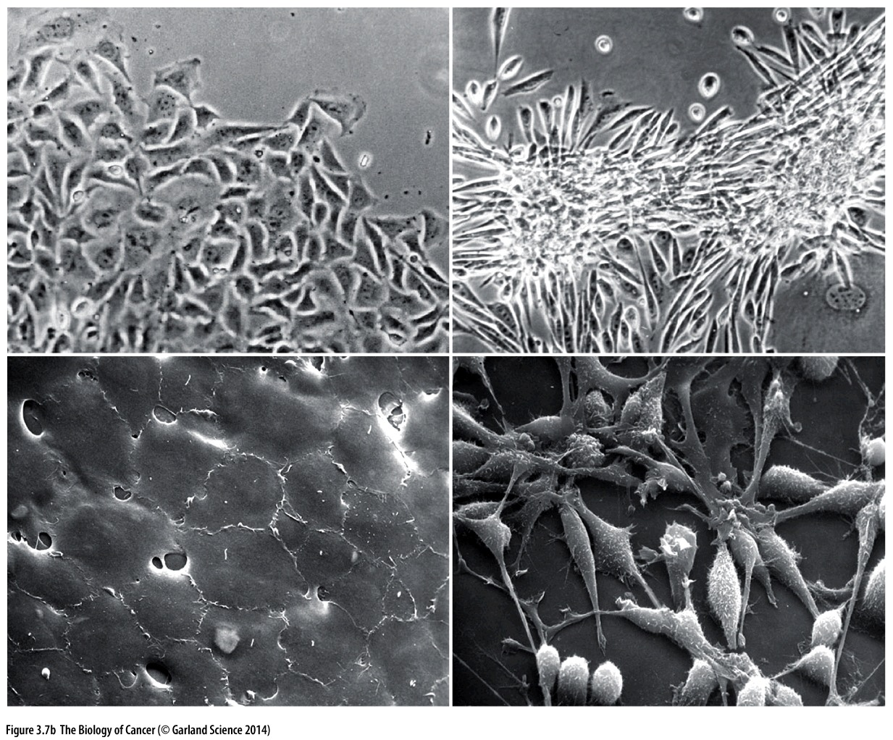
(B) The effects of RSV infection and transformation can be observed through both phase-contrast microscopy (upper panels) and scanning electron microscopy (lower panels). Normal chicken embryo fibroblasts are spread out and form a continuous monolayer (left panels). However, upon transformation by RSV, they round up, become refractile (white halos, upper right panel), and pile up upon one another (right panels).
Transformed cells lost the ability of contact inhibition

Slide 31
3.3 The continued presence of RSV is needed to maintain transformation
Notes:
进一步研究发现…

Slide 32
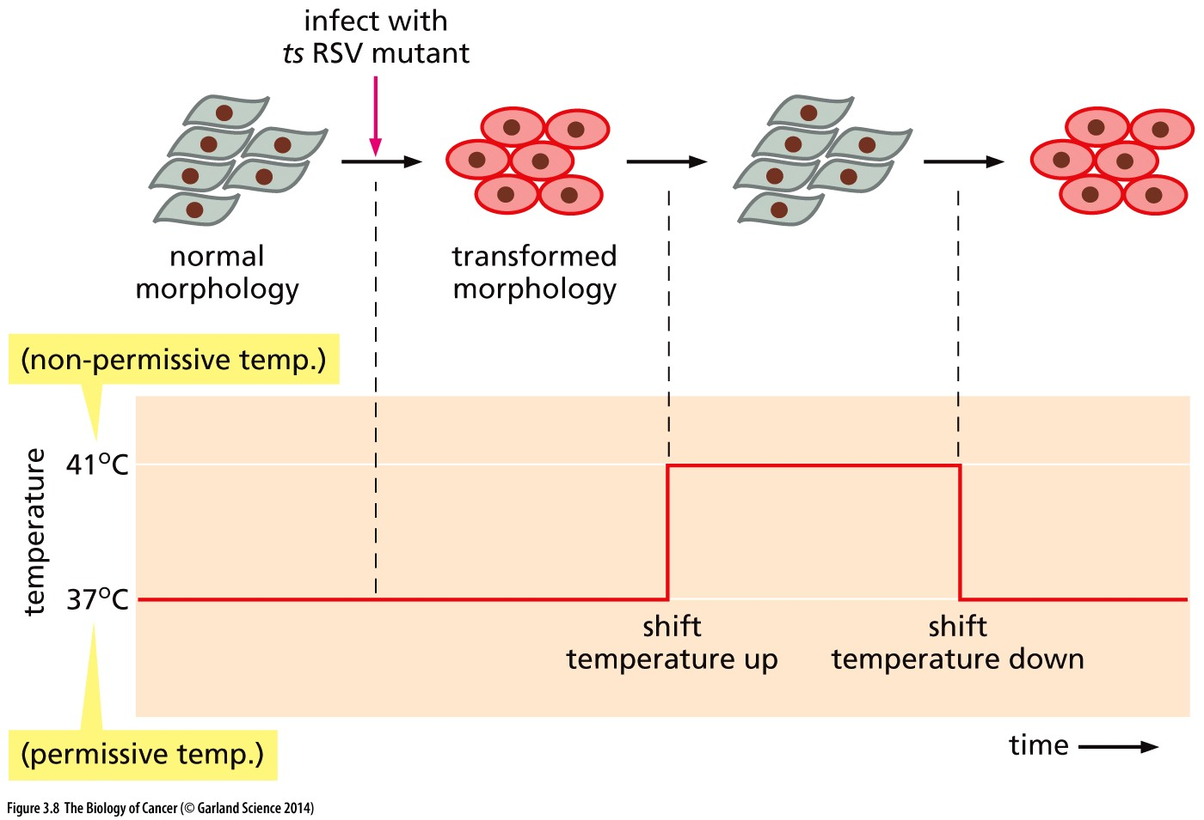
Figure 3.8 Temperature-sensitive mutant and the maintenance of transformation by RSV
Notes:
目前有其他方法调控基因的时空表达，比如Tetracycline诱导性启动字。

Slide 33
3.4 Viruses containing DNA molecules are also able to induce cancer
RSV was only one of a disparate group of viruses that were found able to induce tumors in infected animals. By 1960, four other classes of tumor viruses had become equally attractive agents for study by cancer biologists. One of them was a tumor virus that was discovered almost a quarter century after Rous’s pioneering work. This virus, discovered by Richard Shope in rabbits, caused papillomas (乳头状瘤) on the skin. These were really benign lesions, which on rare occasions progressed to true tumors—squamous cell carcinomas of the skin.

Slide 34
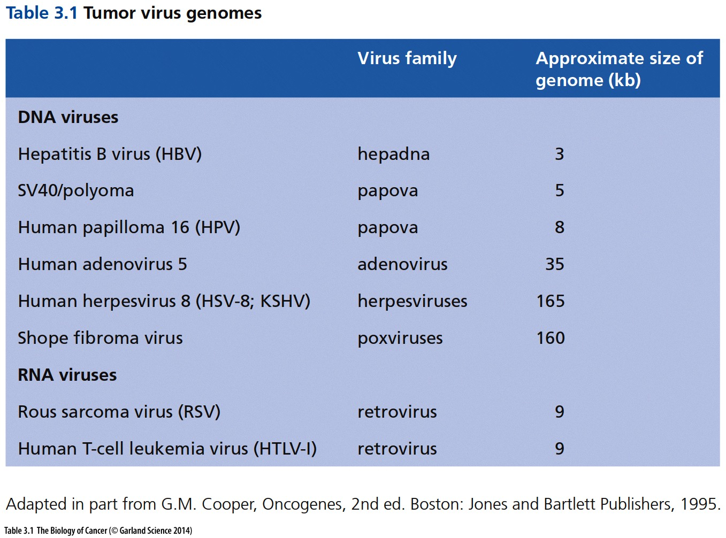

Slide 35
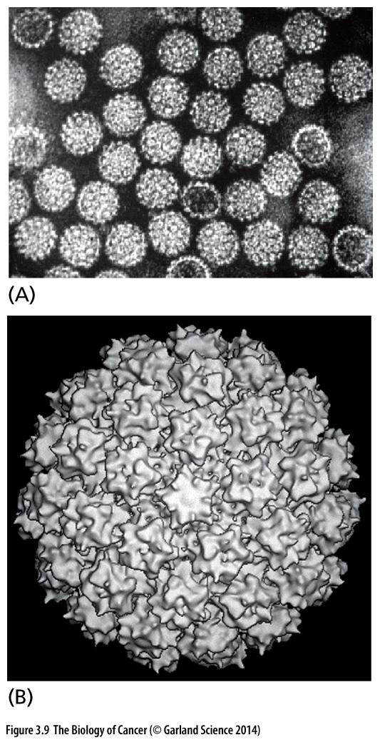
Figure 3.9 Shope papillomavirus
(A) Electron micrograph of Shope papillomavirus(乳头瘤病毒). Virus particles of this class carry dsDNA genomes and lack a lipid envelope like that of retroviruses.
(B) This cryoelectron micrograph, together with image enhancement, reveals the structure of a human papillomavirus particle.
Shope papillomavirus was discovered almost a quarter century after Rous’s pioneering work.

Slide 36
Polyomavirus（多型瘤病毒）, named for its ability to induce a variety of distinct tumor types in mice, was discovered in 1953. Closely related to polyomavirus in its size and chemical makeup was SV40 virus (the 40th simian(类人猿)virus in a series of isolates).

Slide 37
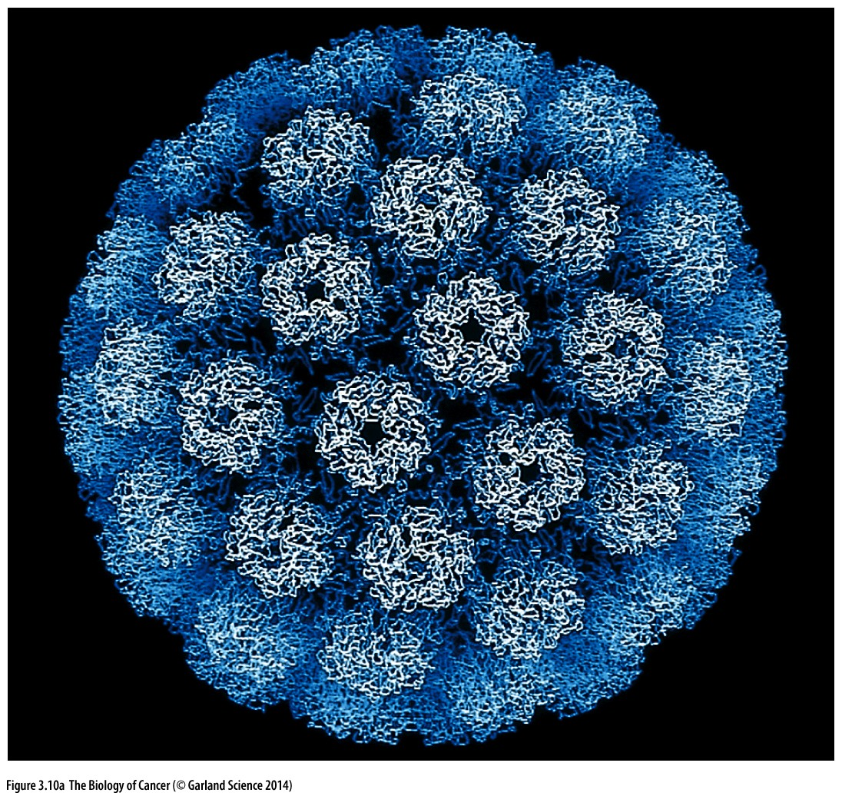
Figure 3.10 SV40 virus
(A) As determined by X-ray diffraction, the protein capsid of the SV40 DNA tumor virus consists of three virus encoded proteins that are assembled into pentamers(五聚体) and hexamers(六聚体) with icosahedral(二十面的) symmetry. The dsDNA genome of SV40 is carried within this capsid.
T antigen of SV40 virus

Slide 38
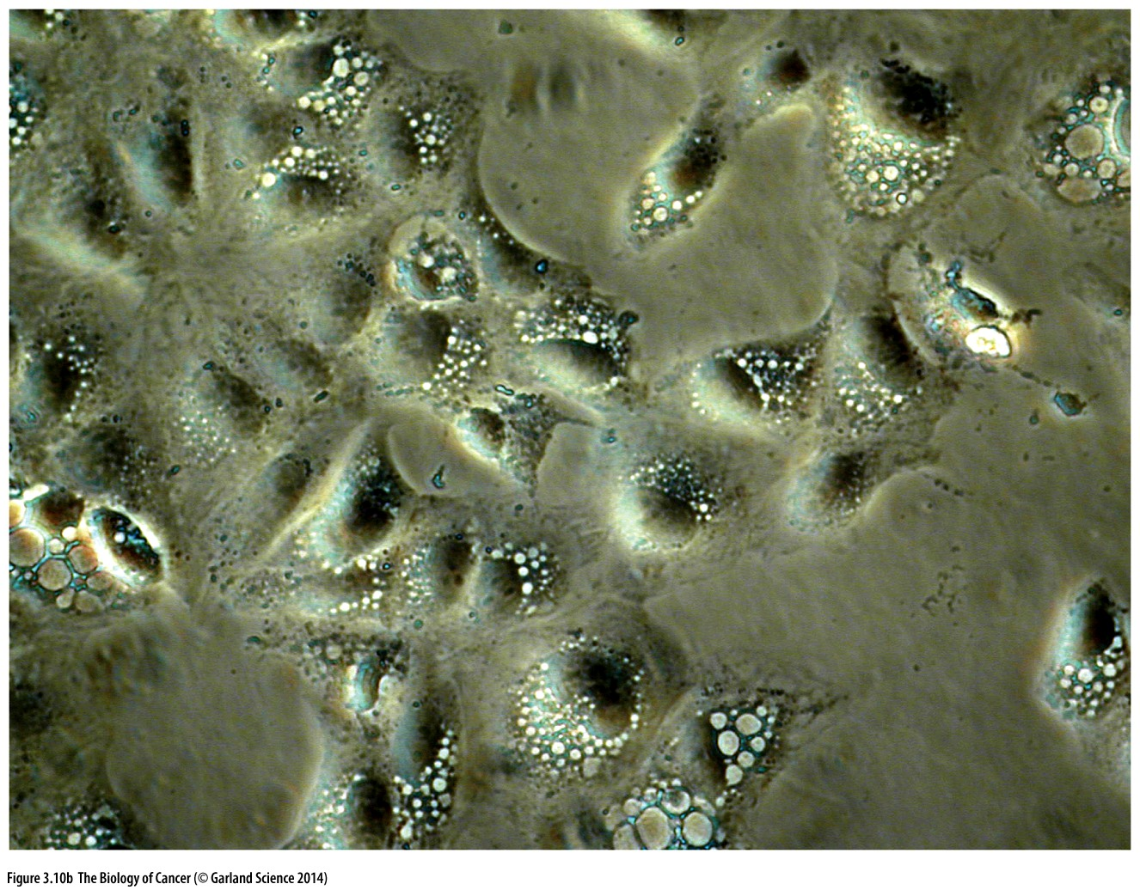
Figure 3.10 SV40 virus
(B) SV40 launches a lytic cycle in permissive host cells, such as the kidney cells of several monkey species. The resulting cytopathic effect, seen here, involves the formation of large cytoplasmic vacuoles prior to the death of the cell and the release of tens of thousands of progeny virus particles.

Slide 39
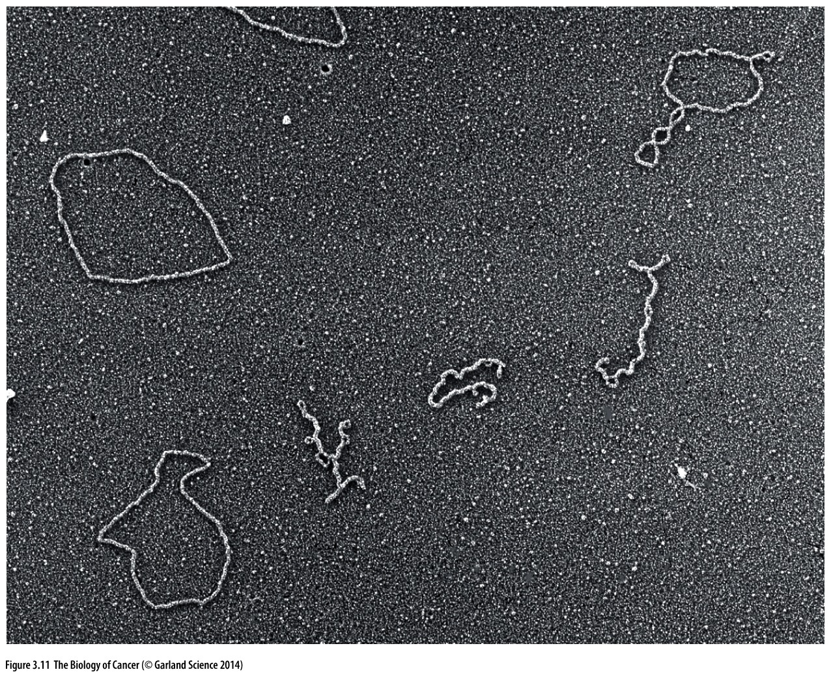
Figure 3.11 Papovavirus genomes
Electron-microscopic analyses revealed the structure of DNA genomes of papovaviruses to be double-stranded and circular. Shown are the closed circular, supercoiled form of SV40 DNA (form I; kinked(纽绞) DNAs) and the relaxed, nicked circular form (form II; open, spread circles). Form III, which is a linear form of the viral DNA resulting from a double-strand DNA break, is not shown.
Shope’s papillomavirus, the mouse polyomavirus, and SV40 were grouped together as the papovavirus class of DNA tumor viruses, the term signifying papilloma, polyoma, and the vacuoles induced by SV40 during its lytic infection.

Slide 40
3.5 Tumor viruses induce multiple changes in cell phenotype including acquisition of tumorigenicity
Notes:
上世纪50-80年代，通过病毒研究肿瘤，原因在于病毒基因组小，让复杂的肿瘤问题简化。一些病毒能够转化细胞，如RSV，SV40

Slide 41
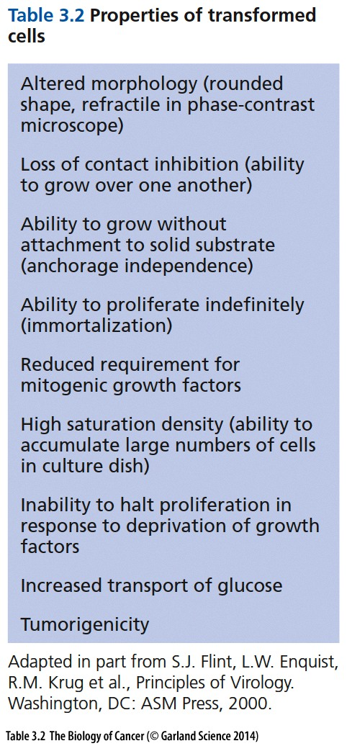
Notes:
总结转化细胞的特征

Slide 42
Cell immortalization: Ability of cells to proliferate Indefinitely in culture;
Anchorage independence: The ability to multiply without attachment to the solid substrate provided by the bottom of the Petri dish

Slide 43
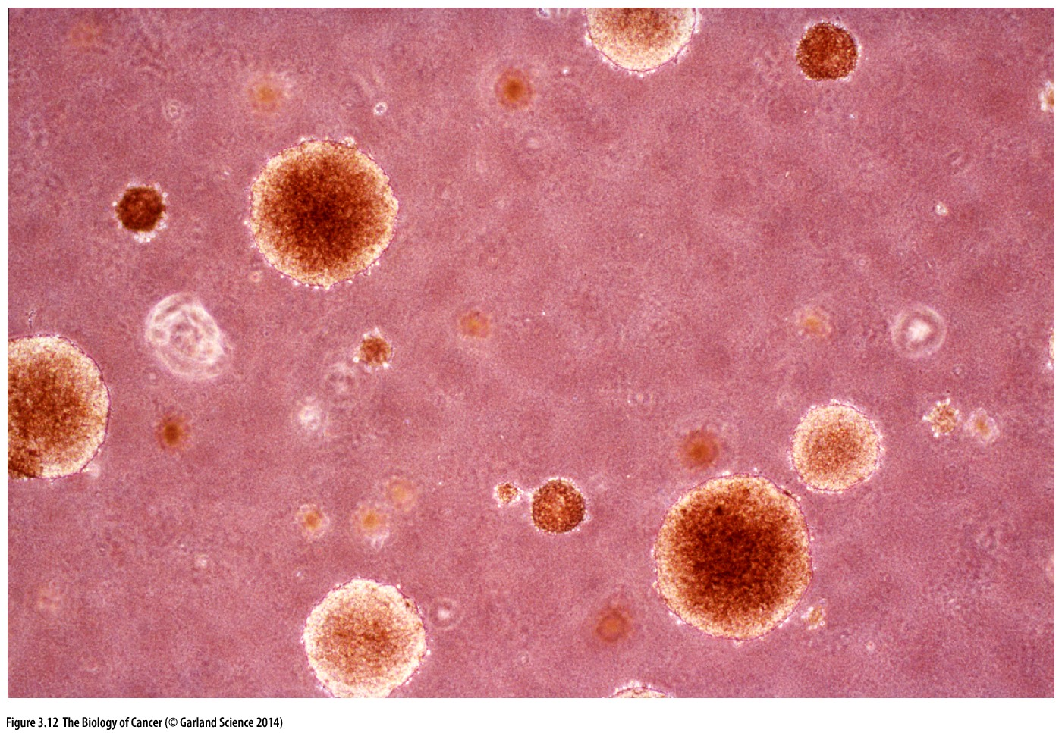
Figure 3.12 Anchorage-independent growth
A photomicrograph of colonies of cells growing in an anchorage independent fashion. (Each of the larger colonies seen here may contain several hundred cells.) This test is usually performed by suspending cells in a semi-solid medium, such as agarose or methylcellulose, to prevent their attachment to a solid substrate, specifically, the bottom of the Petri dish. The ability of cells to proliferate while held in suspension—the phenotype of anchorage independence—is usually a good (but hardly infallible(万无一失的)) predictor of their ability to form tumors in vivo.

Slide 44
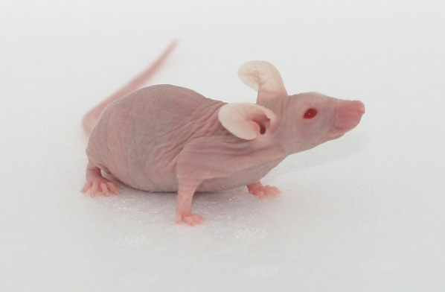
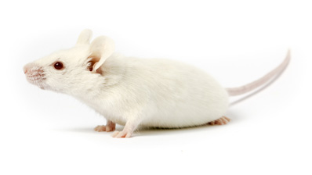
Immunocompromised host for tumorigenic assay
Nude mouse is a laboratory mouse from a strain with a genetic mutation that causes a deteriorated or absent thymus, resulting in an inhibited immune system due to a greatly reduced number of T cells. The phenotype, or main outward appearance of the mouse is a lack of body hair, which gives it the "nude" nickname. The genetic basis of the nude mouse mutation is a disruption of the FOXN1 gene.
NSG, or NOD scid gamma (NOD.Cg-Prkdcscid Il2rgtm1Wjl/SzJ), is a strain of inbred laboratory mice, among the most immunodeficient described to date. NSG mice lack mature T cells, B cells, and natural killer (NK) cells. NSG mice are also deficient in multiple cytokine signaling pathways, and they have many defects in innate immunity.

Slide 45
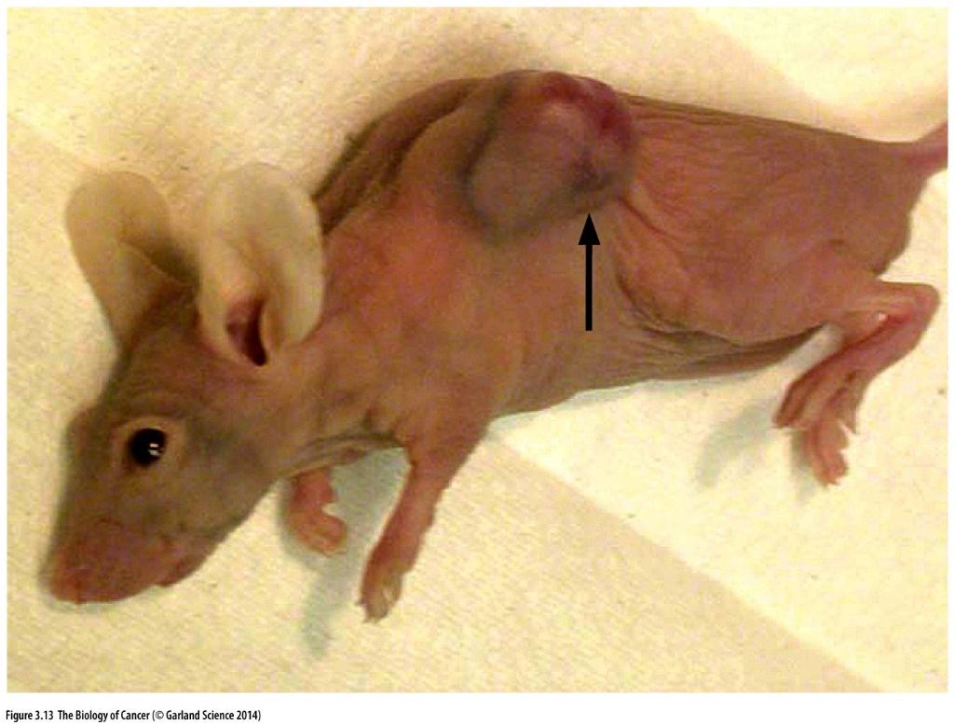
Figure 3.13 Nude mice
Mice of the Nude strain offer two advantages in tests of tumorigenicity. Lacking a thymus, they are highly immunocompromised and therefore relatively receptive to engrafted cells from genetically unrelated sources, including those from foreign species. In addition, because these mice are hairless, it is easy to monitor closely the progress of tumor formation (arrow) after transformed cells have been injected under their skin.

Slide 46
3.6 Tumor virus genomes persist in virus-transformed cells by becoming part of host-cell DNA

Slide 47
Tumor-associated proteins (T antigens)
The display of the virus-induced T antigen correlated directly with the transformed state of these cells. Therefore, cells that lost the T antigen would also lose the transformation phenotype induced by the virus. This correlation suggested, but hardly proved, that the viral gene sequences responsible for transformation were associated with or closely linked to viral sequences encoding the T antigen.
SV40 T antigen, a widely used tools for inducing cell transformation
Notes:
DNA病毒的研究与RNA病毒研究几乎同时进行，细胞转化依赖于病毒基因组的部分元件。。。

Slide 48
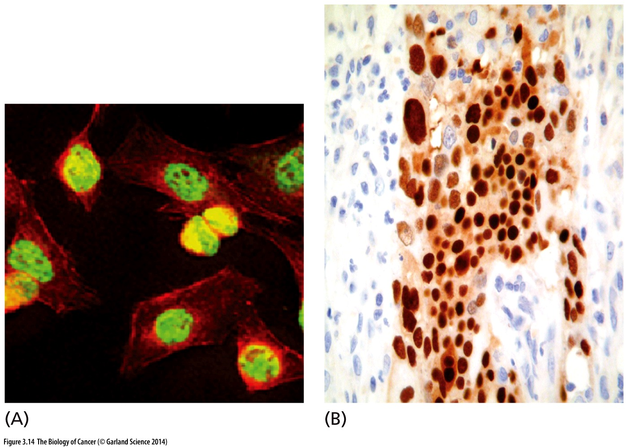
Figure 3.14 Expression of the SV40 T antigen
When SV40- transformed cells are introduced into a syngeneic(同源的) host, they provoke a strong immune response against the SV40-encoded T antigen (tumor antigen), which is usually termed “large T” (LT). Anti-LT serum, together with appropriate immunofluorescent tags, can be used to stain virus transformed cells.

Slide 49
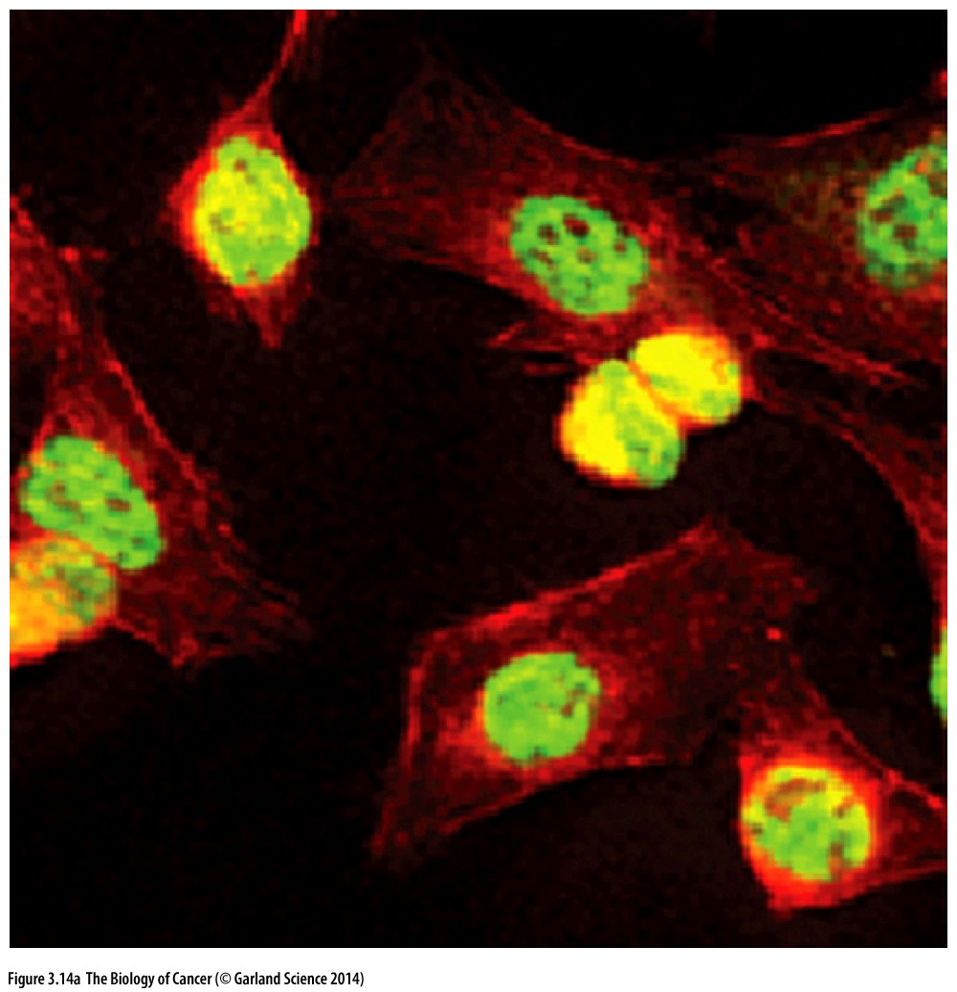
Figure 3.14 Expression of the SV40 T antigen
(A) In the light micrograph shown here, an anti-LT monoclonal antibody has been used to stain mouse cells that have been transformed by SV40, revealing the nuclear localization of LT (green); the cytoplasm of each cell has been stained with phalloidin (red), which reveals the actin fibers of the cytoskeleton.

Slide 50
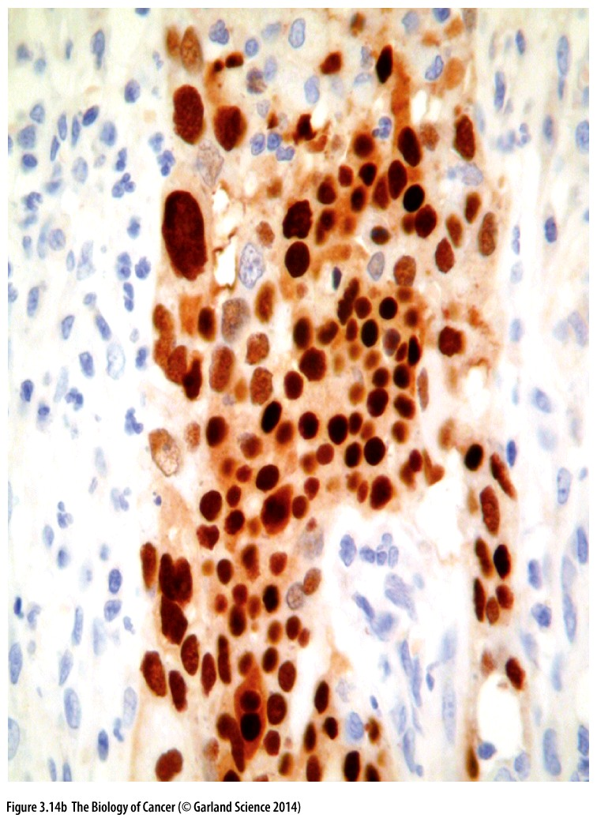
Figure 3.14 Expression of the SV40 T antigen
(B) While SV40 itself rarely if ever causes human tumors (see Section 3.4), immunosuppression can allow an otherwise latent close cousin of SV40, termed BK virus, to become active and occasionally oncogenic. Seen here is a urothelial (bladder) carcinoma arising in a kidney transplant patient. The tumor cells show strong staining for T antigen (brown), while the nearby normal urothelial cells are unstained. (The tumor cell nuclei show dramatic variations in size.)
Notes:
一些DNA病毒表达肿瘤抗原，如SV40病毒

Slide 51
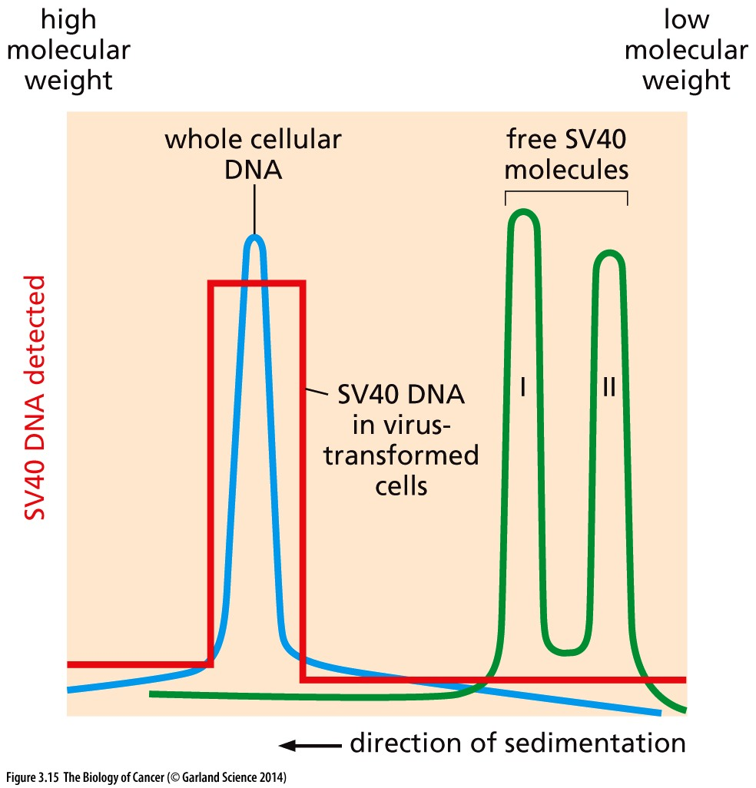
Figure 3.15 Integration of SV40 DNA
DNA molecules from SV40-transformed cells were isolated and sedimented by centrifugation through an alkaline solution stabilized by a sucrose gradient. Under these conditions, the high–molecular-weight cellular DNA (blue) sedimented a substantial distance down the sucrose gradient (left side of graph). In contrast, the SV40 DNA isolated from virus particles (green) sedimented more slowly, indicative of its lower molecular weight. Forms I and II viral DNA refer to the closed circular and nicked circular DNAs of SV40, respectively. Use of nucleic acid hybridization revealed that the SV40 DNA sequences in SV40 virus–transformed cells co-sedimented with the high–molecular-weight chromosomal DNA of the virus-transformed cells, indicating covalent association of the viral genome with that of the host cell (red).
Notes:
检测目标DNA是否整合到宿主基因组染色体的方法：密度梯度离心

Slide 52
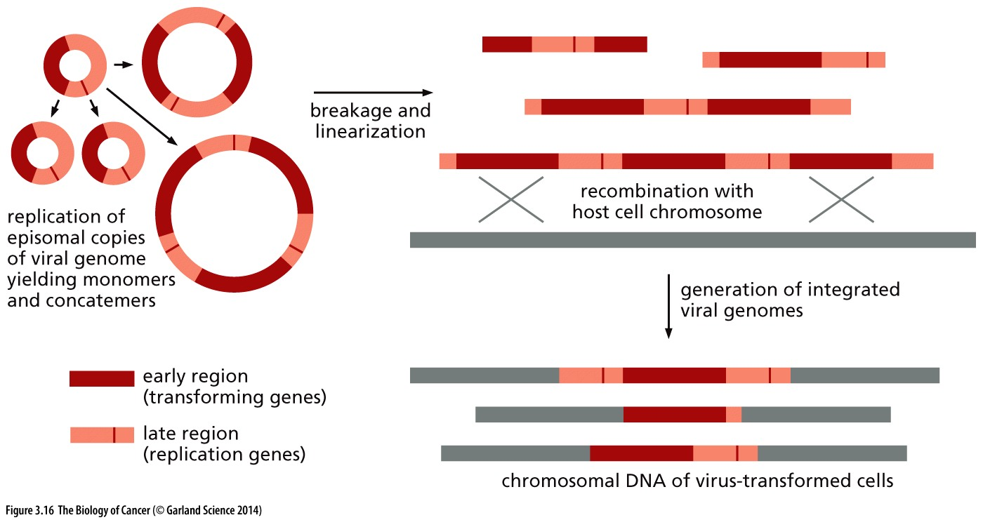
Figure 3.16 Formation of integrated SV40 genomes
多联体

Slide 53
More common, however, are molecular strategies that allow DNA tumor viruses to maintain their genomes as episomes (unintegrated genetic elements) over many cell generations. Like chromosomal integration, these strategies enable certain herpesviruses（疱疹病毒）, such as Kaposi’s sarcoma herpesvirus (KSHV/HHV-8), as well as HPV, to maintain chronic infections. Rather than covalently linking their genomes to cellular DNA, these viruses deploy viral proteins that serve as bridges between the episomal viral genomes and cellular chromatin. This allows the viral genomes to “hitchhike(搭便车)” with cellular chromosomes, ensuring nuclear localization during mitosis and proper allocation of viral genomes to daughter cells.
Notes:
Kaposi’s sarcoma herpesvirus （KSHV） induce sarcoma mostly in AIDS patients, 艾滋病病人因为免疫缺陷，KSHV可诱发肉瘤，正常人KSHV感染后不会出现肉瘤。

Slide 54
3.7 Retroviral genomes become integrated into the chromosomes of infected cells

Slide 55
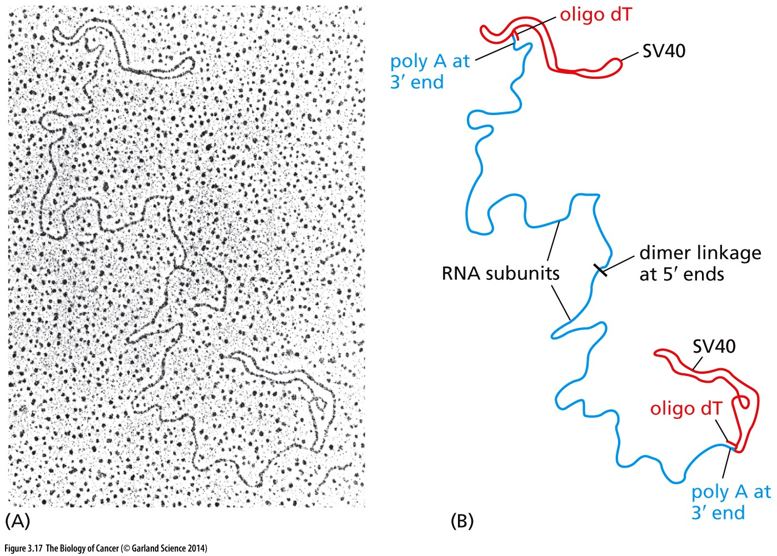
Figure 3.17 Genome structure of RNA tumor viruses
RSV carry single-stranded RNA (ssRNA) genomes. Uniquely, the genomes of this class of viruses were discovered to be diploid, that is, to carry two identical copies of the viral genetic sequence. (A) This electron micrograph shows the genome of baboon endogenous virus, a distant relative of RSV. (B) The identities of the molecules shown in panel A are revealed here. As indicated, circular SV40 dsDNA molecules (red), to which oligo dT (oligodeoxythymidine) tails were attached enzymatically, have been used to visually label the 3′ termini of the two single stranded viral RNA molecules (blue). The viral RNA molecules (like cellular mRNA molecules) contain polyadenylate at their 3′ termini and therefore anneal to the oligo dT tails attached to the circular SV40 molecules. Note also that the two ssRNAs are associated at their 5′ ends.
Notes:
扫描电子显微镜图片，病毒含有2条单链RNA。这是原始的检测手段。

Slide 56
How could RSV succeed in chromosome integration of infected cells?
The process of reverse transcription that Temin proposed—making DNA copies of RNA—was without precedent in the molecular biology of the time, which recognized information flow only in a single direction, specifically, DNA→RNA→proteins. But the idea prevailed, receiving strong support from Temin’s and David Baltimore’s simultaneous discoveries in 1970 that RSV and related virus particles carry the enzyme reverse transcriptase.
Notes:
这个理论问题让Temin有了诺贝尔奖发现。。。

Slide 57
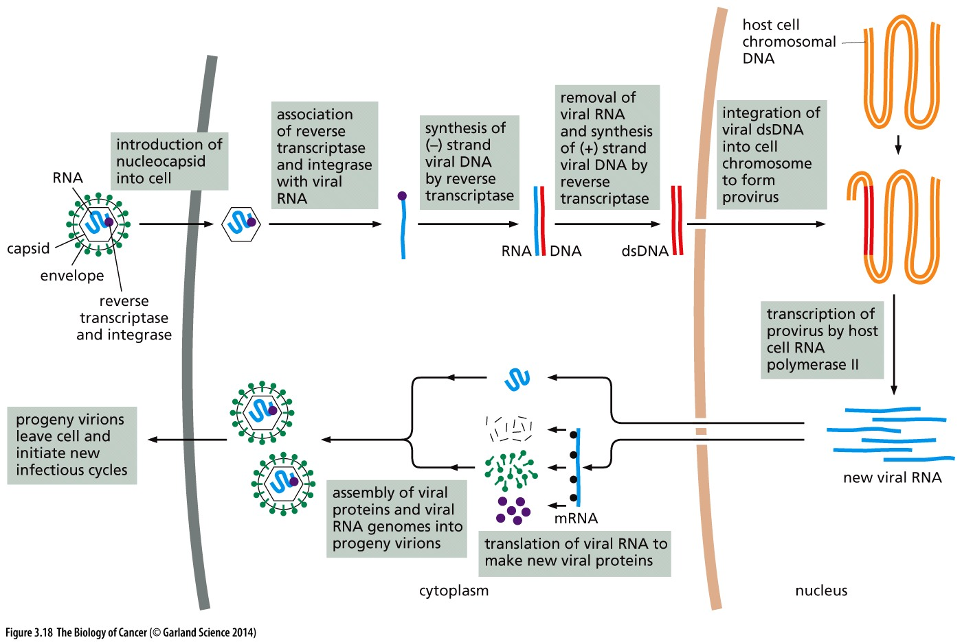
Figure 3.18 The life cycle of an RNA tumor virus like RSV
Notes:
逆转录病毒的生命周期。。。

Slide 58
Distinction between the integration mechanisms used by retroviruses and DNA tumor viruses
Integration is a normal, essential part of the replication cycle of retroviruses. Indeed, retrovirus genomes carry the gene specifying an integrase. This enzyme is encoded by the viral pol gene. Accordingly, during each cycle of infection and replication, the retroviral genome—its provirus— is integrated into the host chromosomal DNA through a precise, ordered process that ensures the presence of the entire viral genome and thus the retention of all viral genes. This contrasts with the behavior of DNA tumor viruses: chromosomal integration of their genomes is a very rare accident (<<1 per 1000 infections).

Slide 59
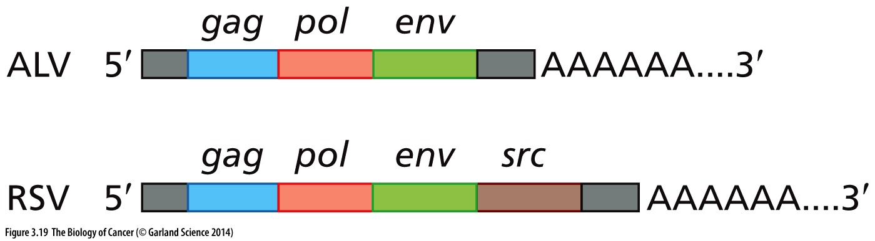
Figure 3.19 Structure of the Rous sarcoma virus genome
Src (pronounced "sarc" as it is short for sarcoma)
The RNA genome of RSV is closely related to that of a relatively common infectious agent of chickens, avian leukosis virus (ALV). Both genomes include the gag gene, which encodes the proteins that, together with the viral RNA, form each virion’s nucleoprotein core (see Figure 3.4); the pol gene, which encodes the reverse transcriptase and integrase; and the env gene, which specifies the glycoprotein spikes of the virion. The RSV genome carries, in addition, a gene (src, brown) that specifies the Src protein, which causes cell transformation. Not indicated here is the specialized cap structure at the 5′ end of these RNA molecules.

Slide 60
3.8 A version of the src gene carried by RSV is also present in uninfected cells
Src (pronounced "sarc" as it is short for sarcoma)
v-src: virus src gene
c-src: cellular src gene
Notes:
又是一个革命性的发现！原来病毒癌基因就在正常细胞内部！！1989诺贝尔奖

Slide 61
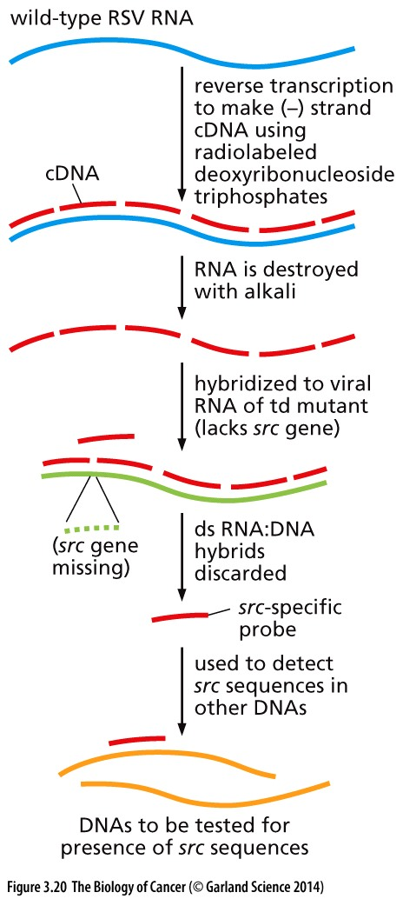
Figure 3.20 The construction of a src-specific DNA probe
Wild-type (wt) RSV RNA (blue) was reverse-transcribed under conditions where only a single-stranded (ss) complementary DNA molecule (a cDNA; red) was synthesized. The wt single-stranded viral DNA was then annealed (hybridized) to viral RNA (green) of a transformation-defective (td) RSV mutant, which had lost its transforming function and apparently deleted its src gene. The resulting ds RNA:DNA hybrids were discarded, leaving behind the ssDNA fragment of the wtDNA that failed to hybridize to the RNA of the td mutant. This surviving DNA fragment, if radiolabeled, could then be used as a src-specific probe to detect src-related sequences in various cellular DNAs (orange).
Varmus-Bishop experiment
Notes:
Stehelin, D.; Varmus, H. E.; Bishop, J. M.; Vogt, P. K. (1976-03-11). "DNA related to the transforming gene(s) of avian sarcoma viruses is present in normal avian DNA". Nature. 260 (5547): 170–173.

Slide 62
1989 Nobel prize
“for their discovery of the cellular origin of retroviral oncogene”

Slide 63
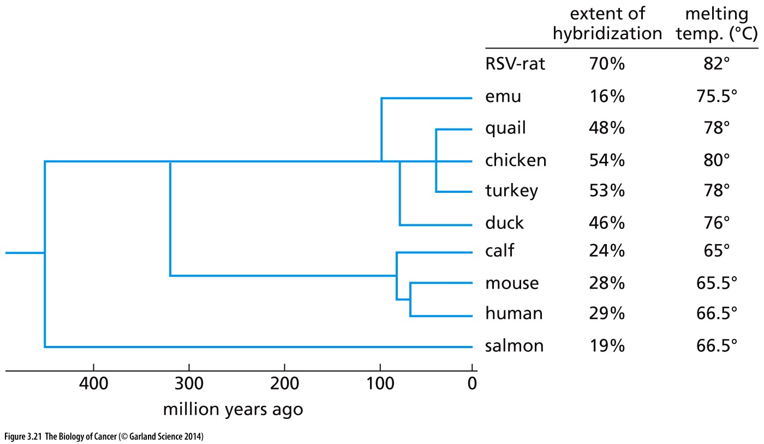
Figure 3.21 Evolutionary tree of the src gene
The src-specific cDNA probe (see Figure 3.20) was annealed with the DNAs of a variety of vertebrate species—whose relatedness to the chicken is indicated on this evolutionary tree—as well as to a rat cell that had recently been infected and transformed by Rous sarcoma virus (RSV).
Notes:
在Sanger发明DNA测序技术(1978年)之前，人们通过DNA杂交的熔炼温度（melting temp.）检测ＤＮＡ同源性

Slide 64
3.9 RSV exploits a kidnapped cellular gene to transform cells

Slide 65
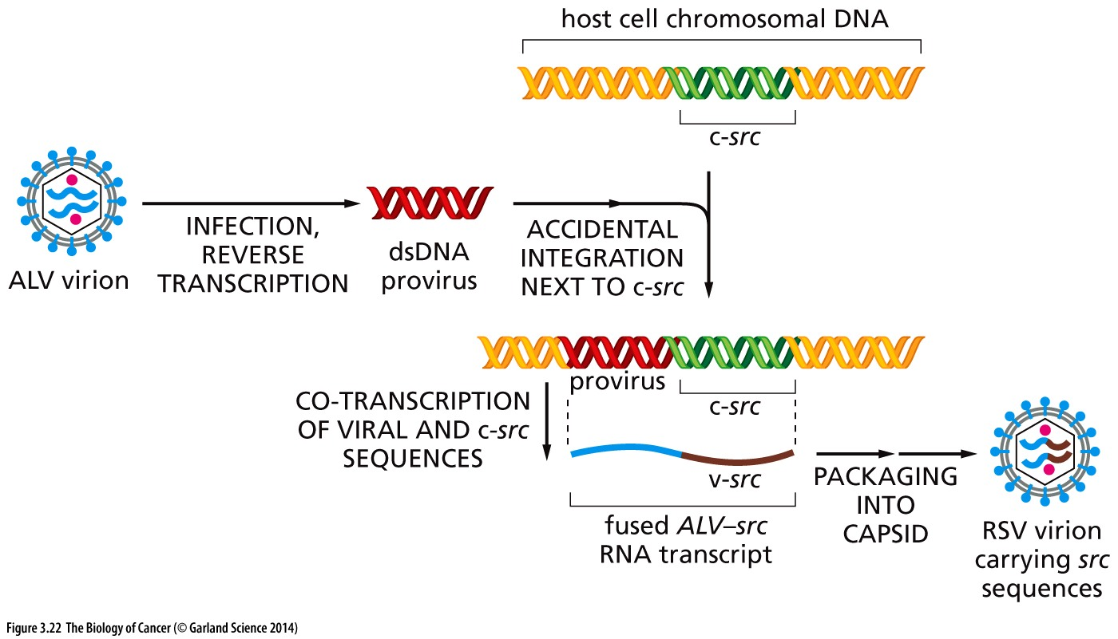
Figure 3.22 Capture of src by avian leukosis virus
The precise mechanism by which an avian leukosis virus (ALV) captured a cellular src gene (c-src) is not known. According to the most accepted model, ALV proviral DNA (red) became integrated (by chance) next to a c-src proto-oncogene (green) in an infected chicken cell. The ALV provirus and adjacent c-src gene were then co-transcribed into a single hybrid RNA transcript (blue and brown). After splicing out c-src introns (not shown), this hybrid viral RNA was packaged into a virus particle that became the ancestor of Rous sarcoma virus (RSV). (Not shown is the attachment of ALV sequences at the 3′side of v-src, with the result that this viral oncogene became flanked on both sides by ALV sequences.)

Slide 66
3.10 The vertebrate genome carries a large group of proto-oncogenes
MC29 myelocytomatosis virus, v-myc oncogene;
Harvey and Kirsten sarcoma viruses, carry the H-ras and K-ras oncogenes.

Slide 67
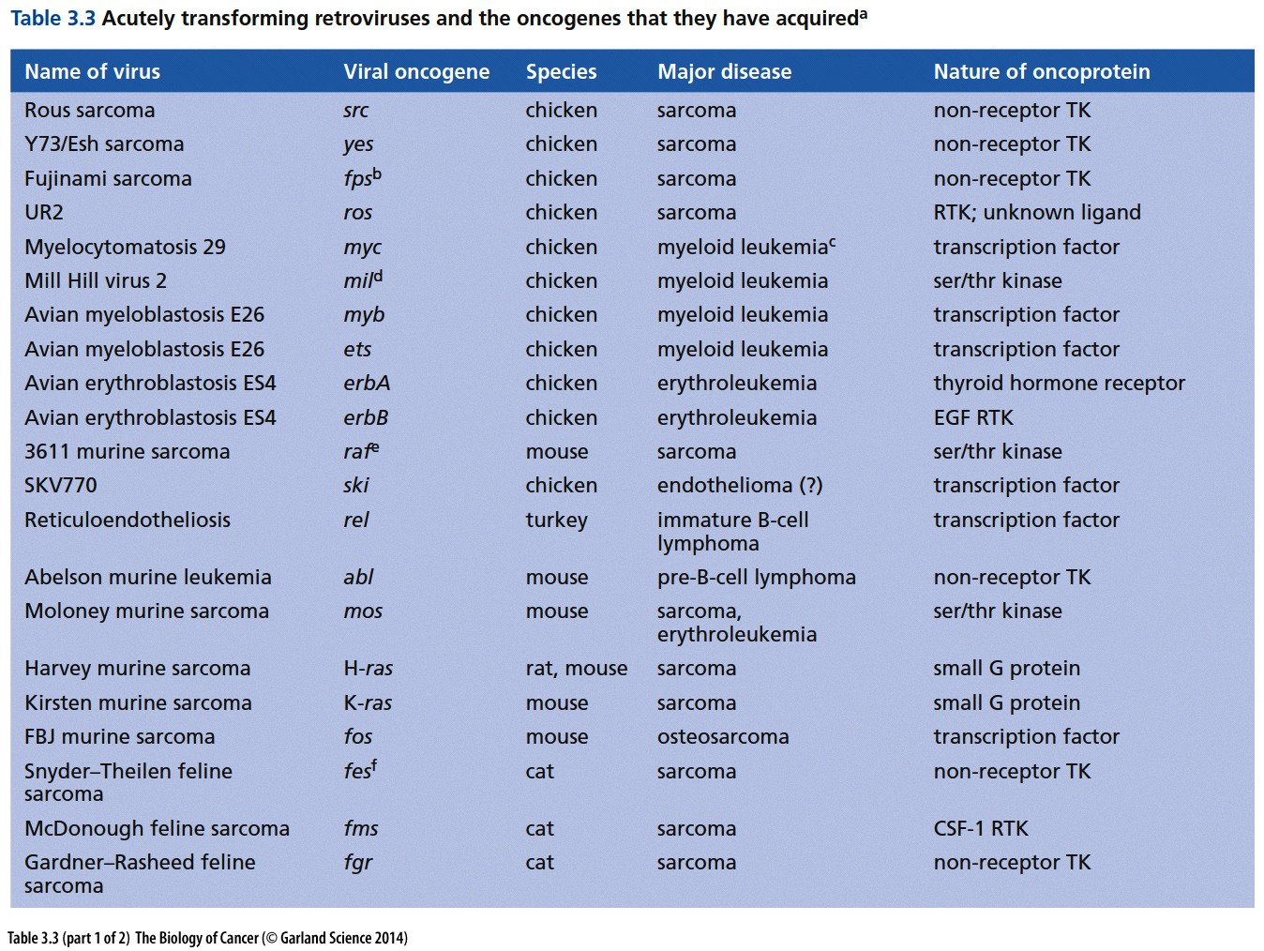
Notes:
注意几乎所有这些快速致肿瘤病毒来源于非人的物种。。。

Slide 68
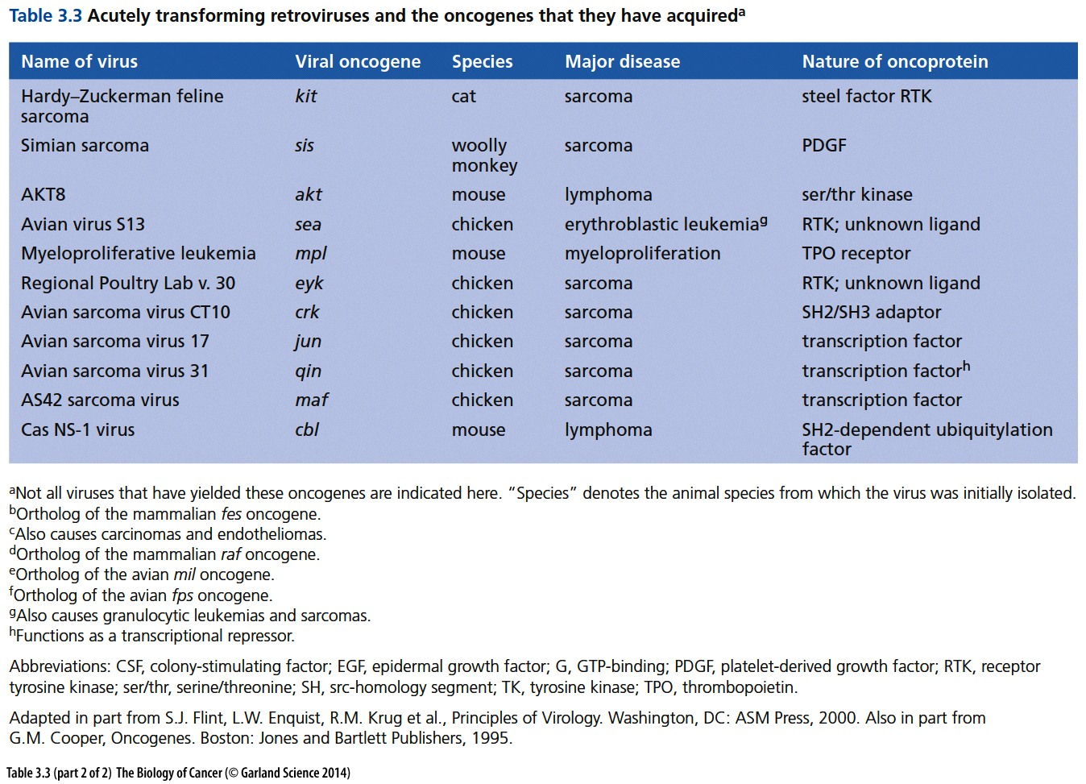

Slide 69
Multiple mechanisms used by virus to transform cells
Retrovirus RSV : kidnap cellular proto-oncogene;
Retrovirus ALV: insertion mutagenesis to activate cellular proto-oncogene;
SV 40 virus: T antigen;
HBV, HCV: Complex including: insertion mutagenesis, inflammation and liver damage;
HPV: E6/E7 proteins
RNA virus
DNA virus
Virus is responsible for about one-fifth of the human cancer. Most significant human cancer virus include: Hepatitis B and C viruses (HBV, HCV), as well as human papillomaviruses (HPVs), these mentioned virus do not have kidnapped cellular proto-oncogene.
Notes:
下次课讲述原癌基因激活的多种途径……

Slide 70
思考题
1，简述Varmus-Bishop 实验的操作过程、主要发现、发现的意义；
2，上世纪60年代Renato Dulbecco实验室开展的体外(In vitro)细胞转化(Cell transformation)试验推动了肿瘤研究的发展。简述体外培养细胞转化和体内(In vivo)正常体细胞向肿瘤细胞转化的共同点及不同点。

